Slide 1
November 2023 release of Power BI apps on telemetry
Dynamics 365 Business Central

Slide 2
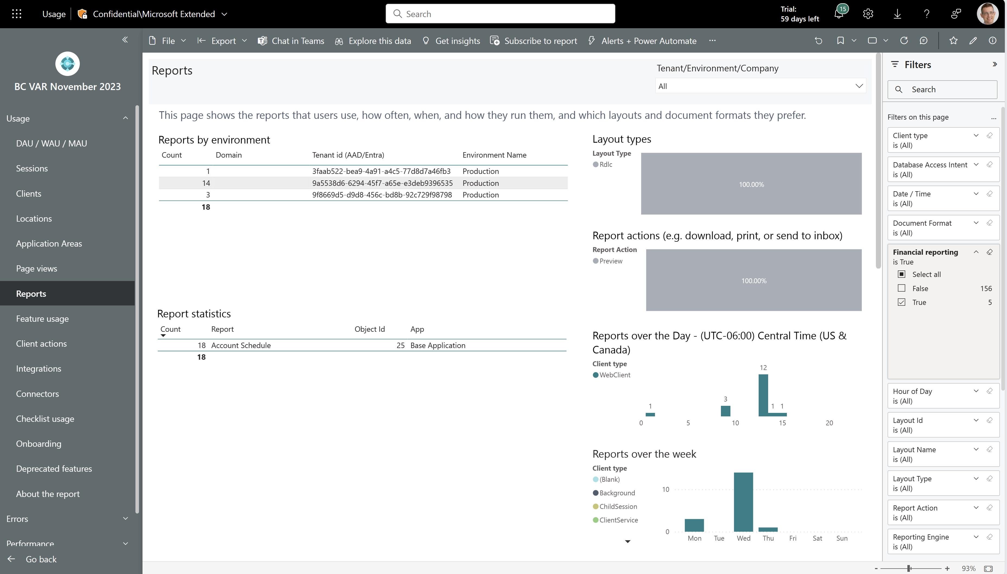
Monitor usage of the Financial Reporting feature
See usage of the Financial Reporting feature across all customers.

Slide 3
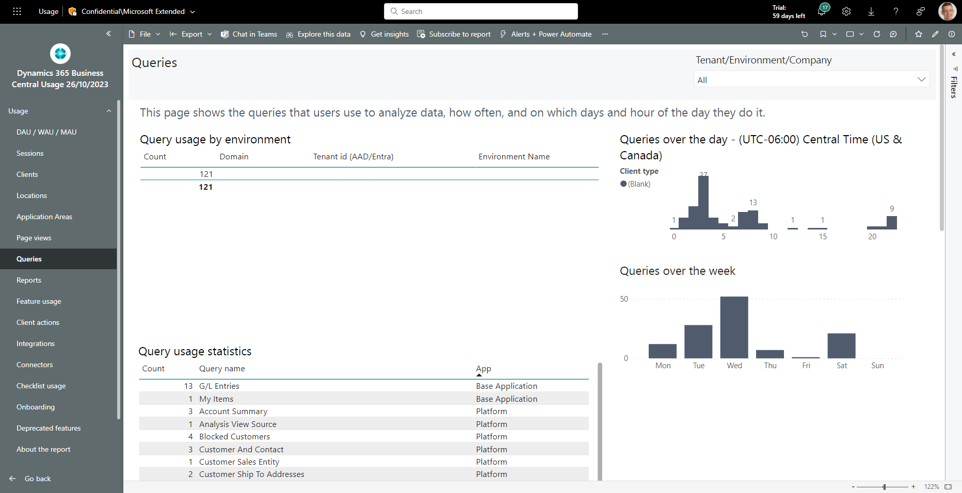
Monitor usage of queries (for data analysis)
See usage of queries (for data analysis) across all customers.

Slide 4
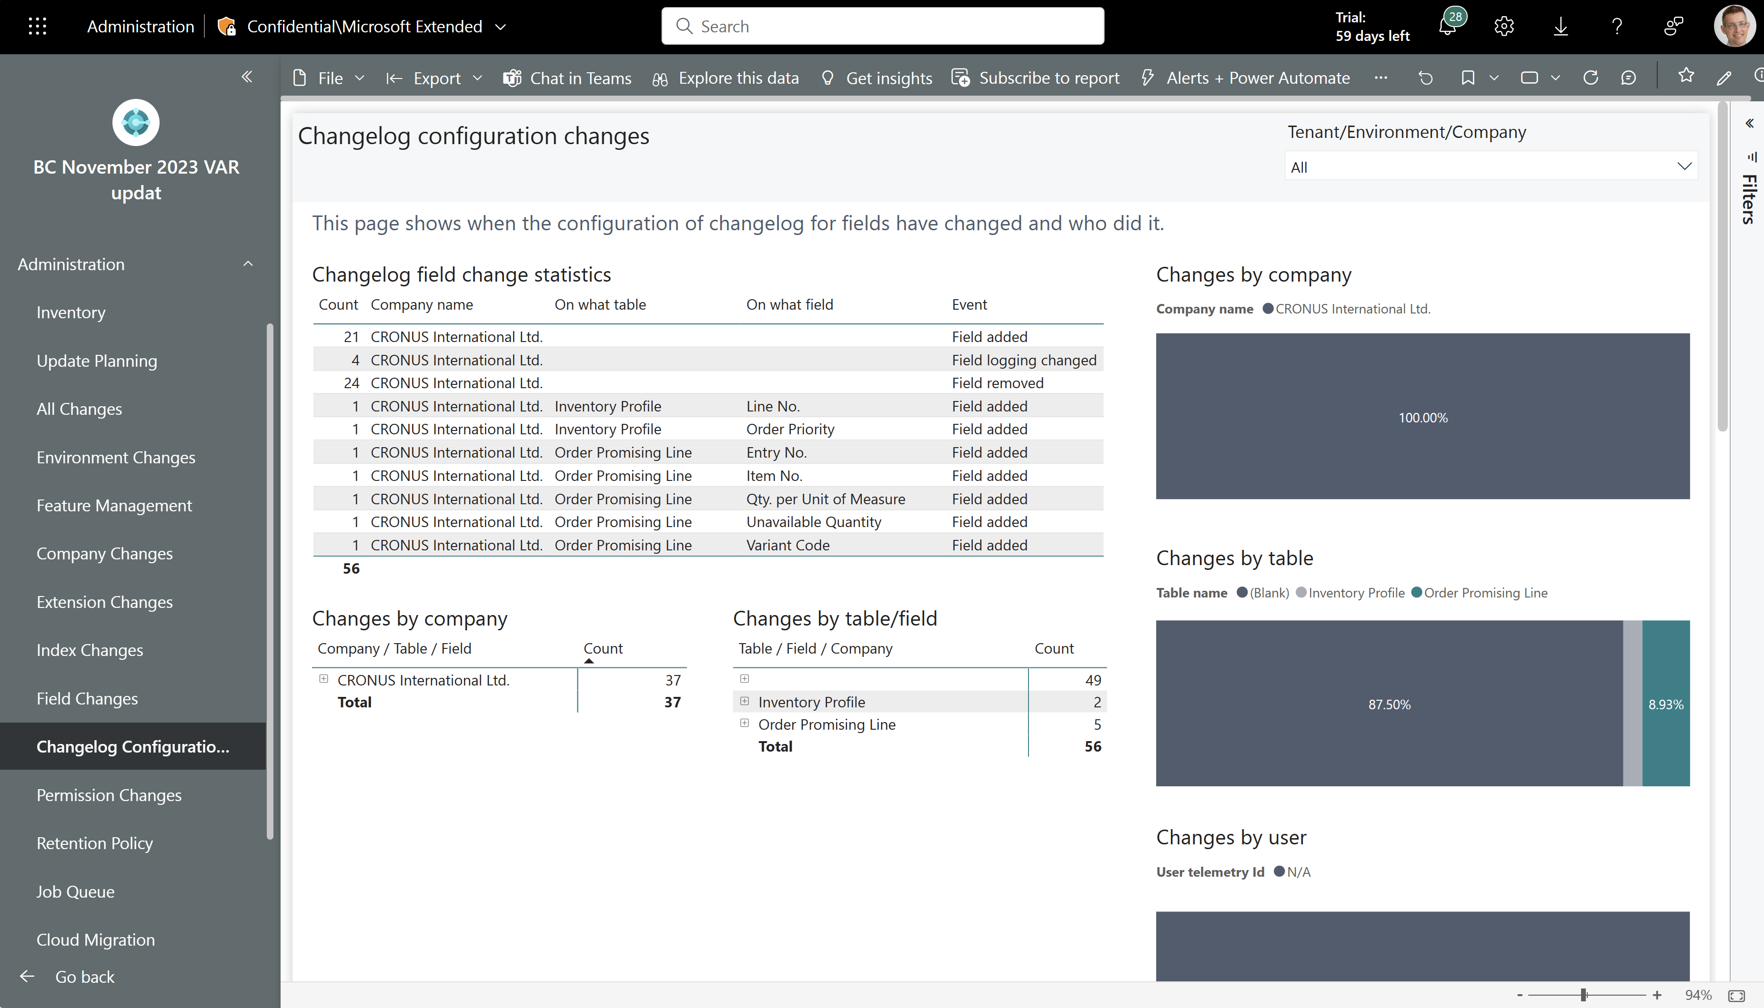
New administrator report: Change log configuration
See all changes to change log configurations that happened across all customers.

Slide 5
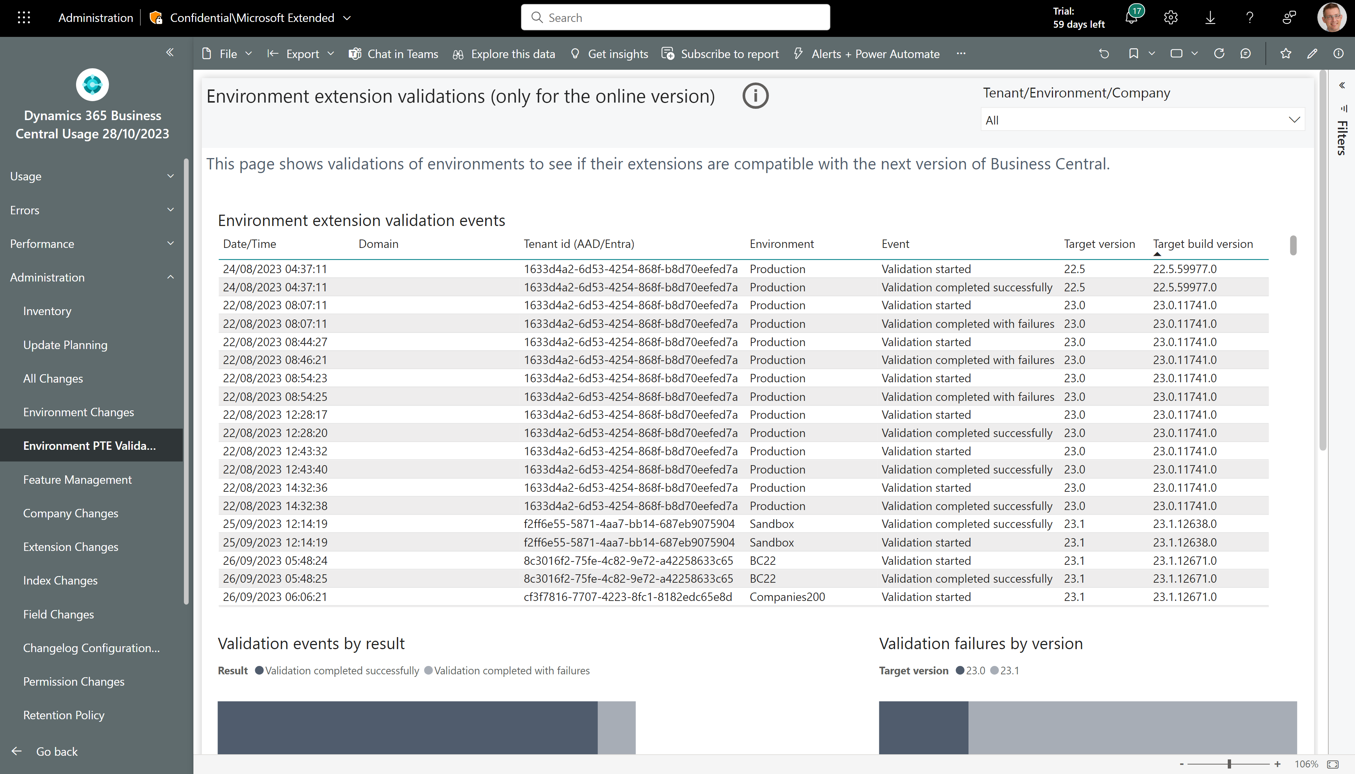
New administrator report: Environment extension validations
See validation results of environments to see if their extensions are compatible with the next version of Business Central.

Slide 6
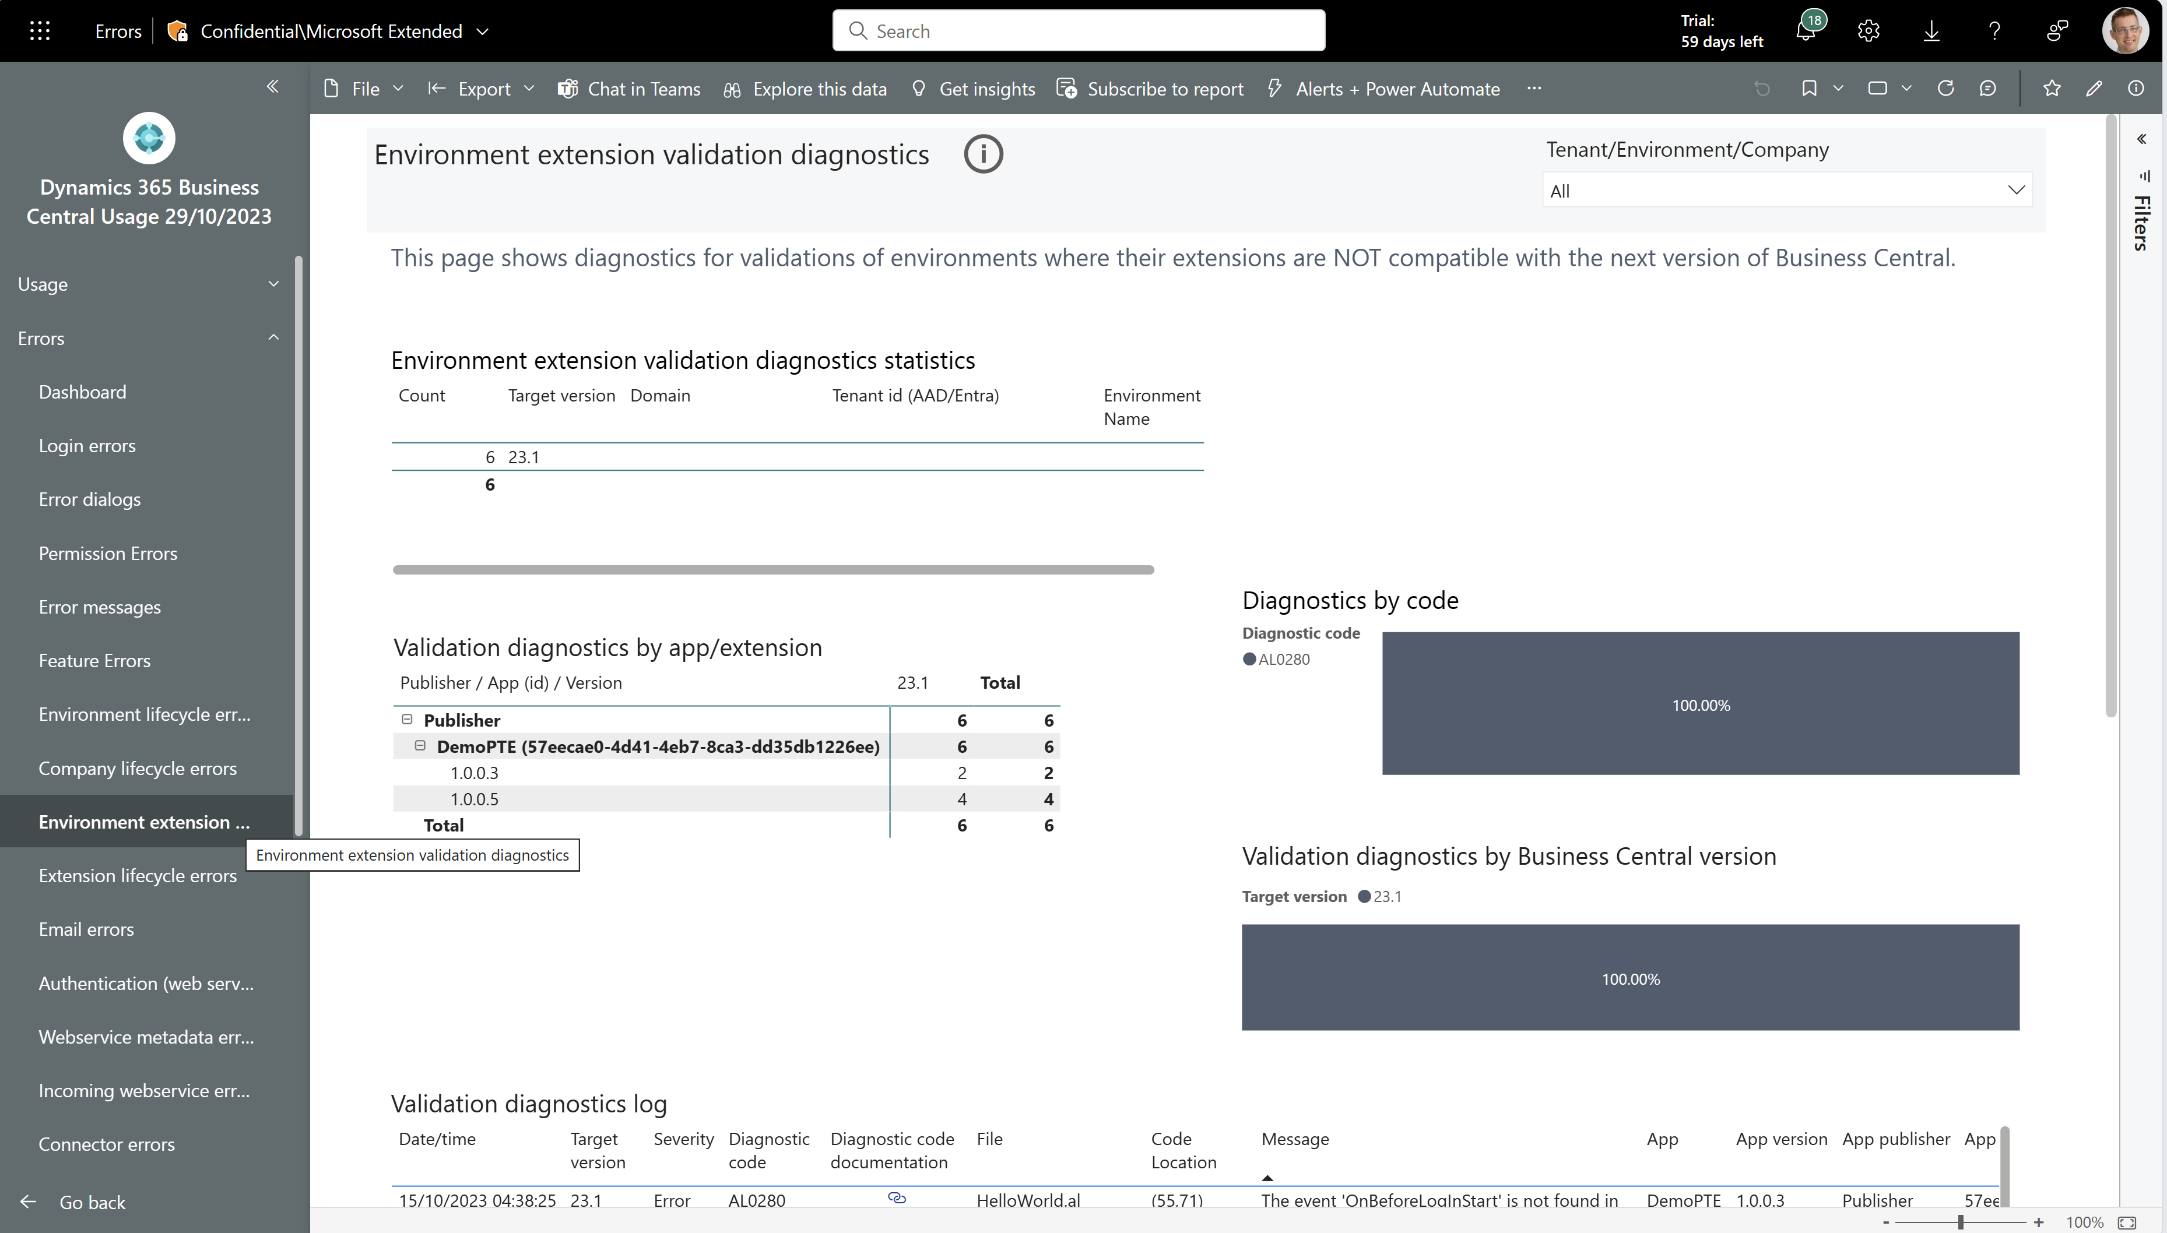
New error report: Environment extension validation diagnostics
See compiler diagnostics of validation results of environments to see if their extensions are compatible with the next version of Business Central.

Slide 7
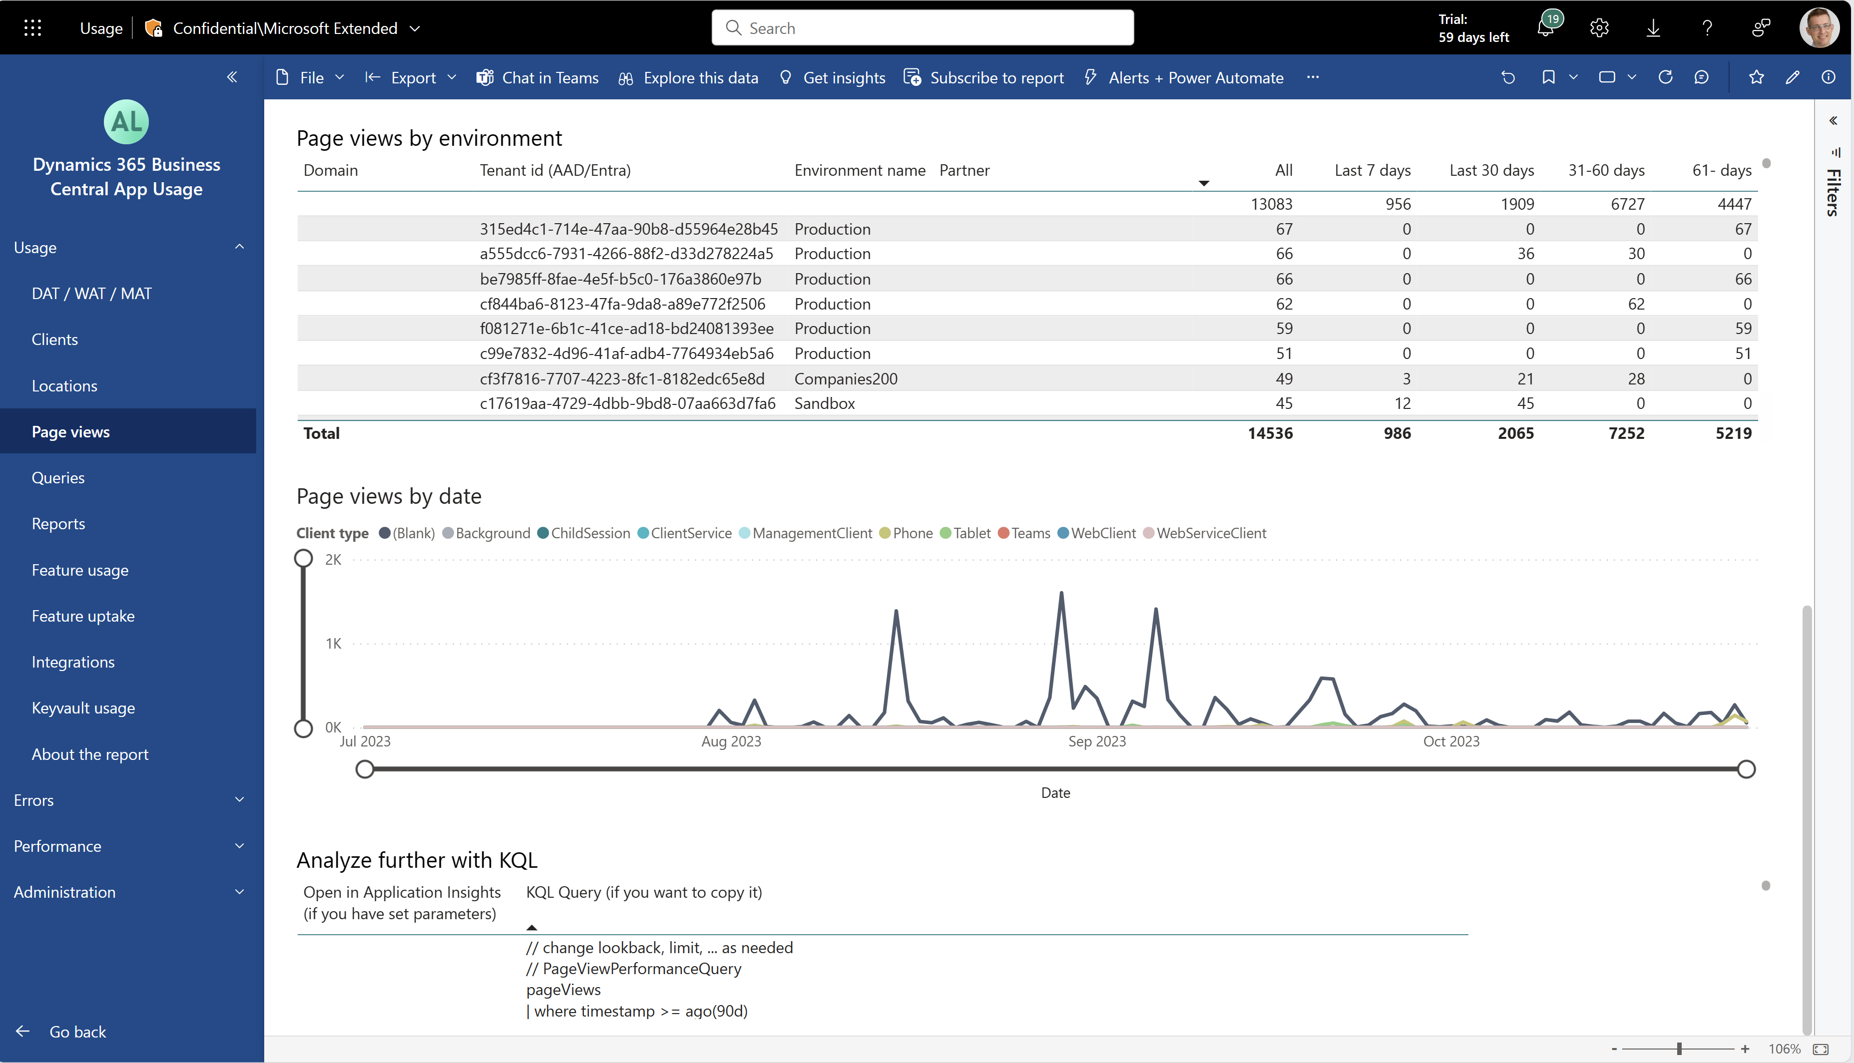
ISV app: Usage pages now show possible churn
See usage of pages, reports, features, and web service integrations over the last 7 days, 30 days, 31-60 days, and 61- days. Use this to detect possible churn by customers.

Slide 8
Get the apps from Appsource
For environment telemetry
https://aka.ms/bctelemetryreport
For app telemetry
https://aka.ms/bctelemetry-isv-app

Slide 9
TEMPLATE
See all changes to change log configurations that happened across all customers.

